Slide 1
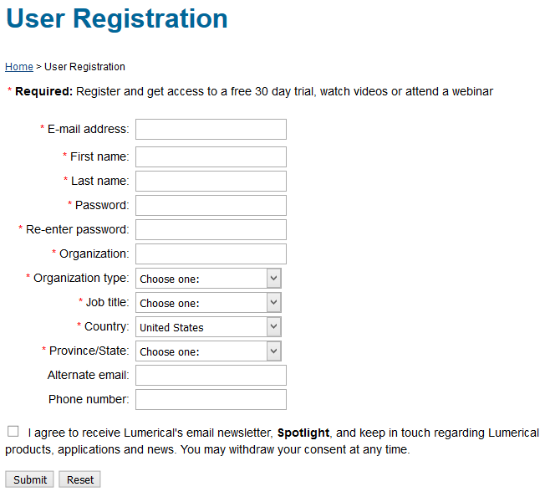
Installing FDTD Solutions
https://www.lumerical.com/register.html
Use @berkeley.edu address

Slide 2
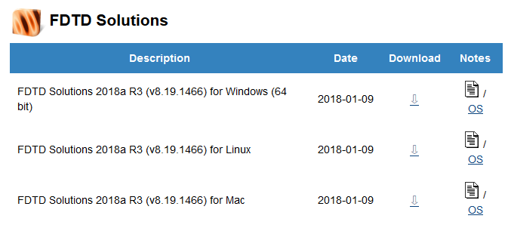
Installing FDTD Solutions
Log in here:
You will get an email with the license code
Download FDTD Solutions
Extract zip file
Run the installer
Start the program
https://www.lumerical.com/portal/workshop.html?ec=CDF54A

Slide 3
Installing FDTD Solutions
Check email for activation code
Enter it here
Click Activate

Slide 4
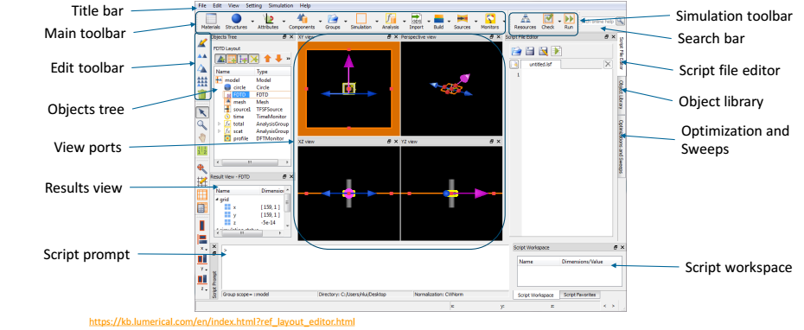
Lumerical FDTD program

Slide 5
Create ‘land’ geometry
We will create a rectangle consisting of Aluminum.
To create a rectangle and edit the properties:
Structures → Rectangle
Right click on rectangle in Objects Tree; select Edit object

Slide 6
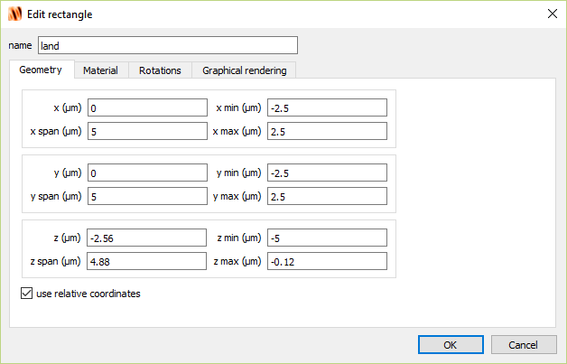
Create ‘land’ geometry

Slide 7
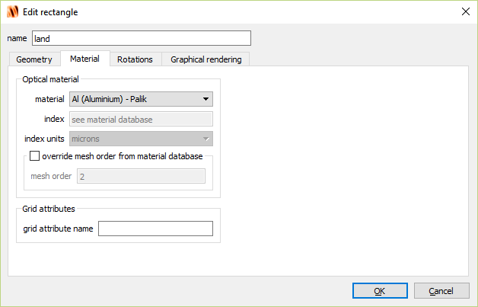
Create ‘land’ geometry

Slide 8
Create simulation window
To create a simulation window and edit the properties:
Simulation → Region
Right click on FDTD in Objects Tree; select Edit object

Slide 9
Create simulation window

Slide 10
Create simulation window

Slide 11
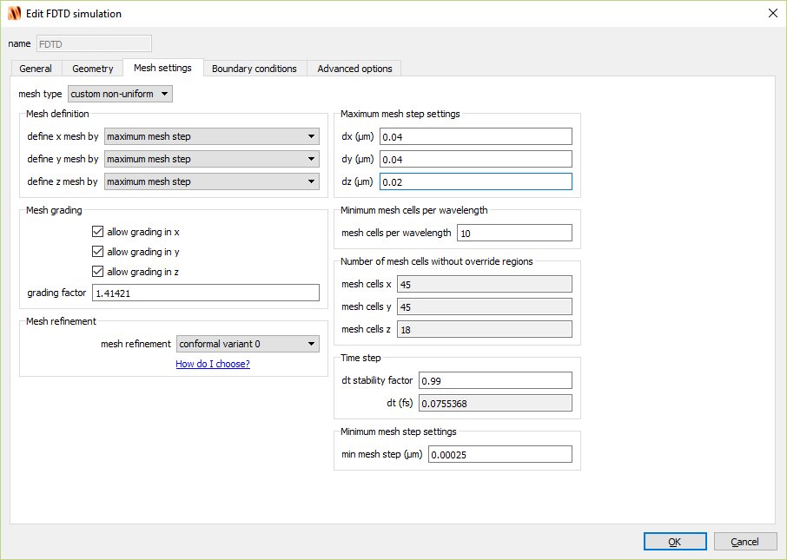
Create simulation window

Slide 12
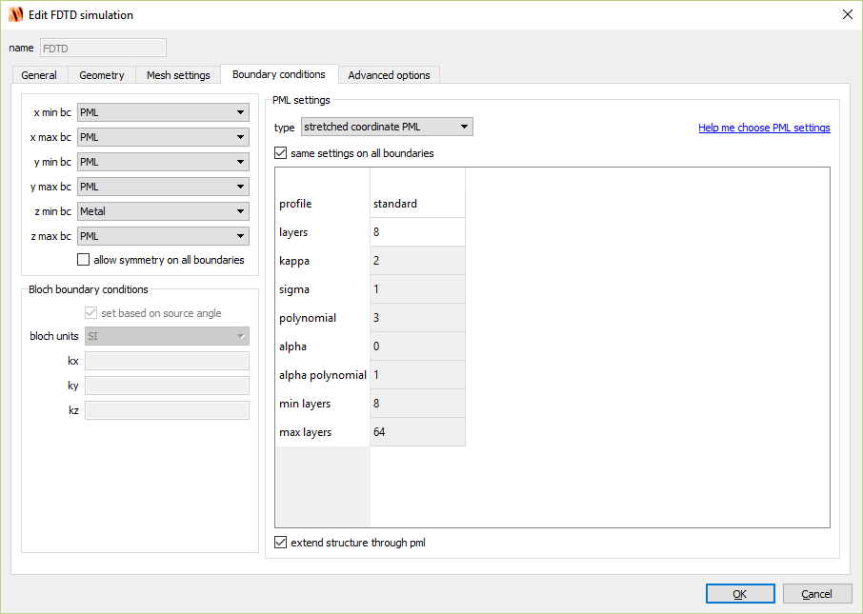
Create simulation window

Slide 13
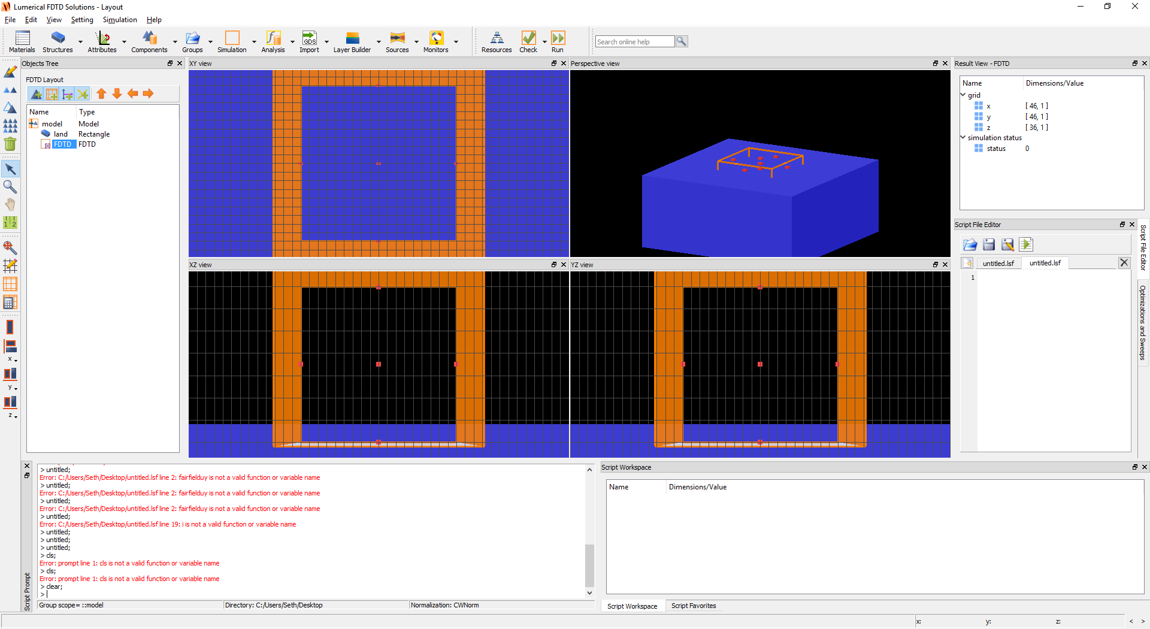
Create simulation window
Hint: Click FDTD in the Objects Tree then click Zoom extents icon on the left-hand side

Slide 14
Create source
To create a source and edit the properties:
Sources → Gaussian
Right click on source in Objects Tree; select Edit object

Slide 15
Create source

Slide 16
Create source

Slide 17
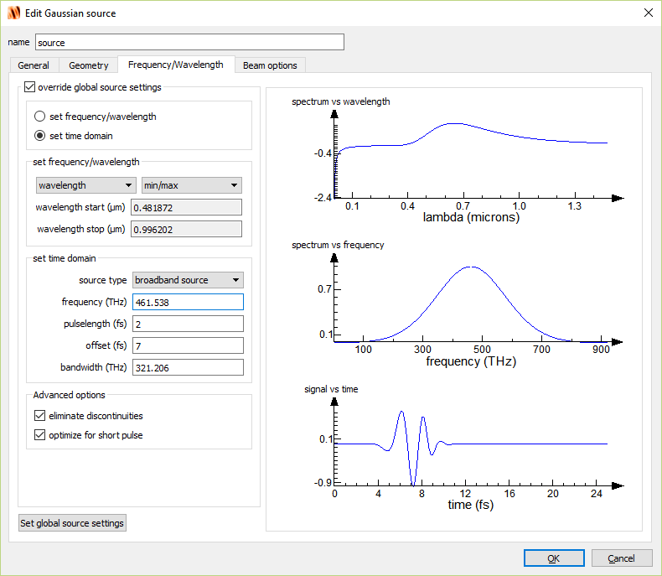
Create source

Slide 18
Create source

Slide 19
Create field monitor
To create a monitor and edit the properties:
Monitors → Frequency-domain field and power
Right click on DFTMonitor in Objects Tree; select Edit object

Slide 20
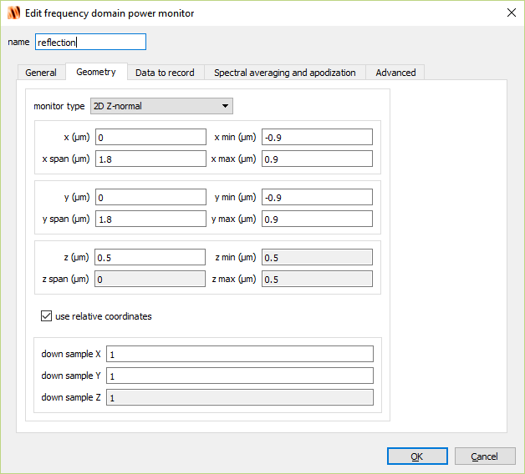
Create field monitor

Slide 21
Create time-domain monitor
To create a monitor and edit the properties:
Monitors → Frequency-domain field and power
Right click on DFTMonitor in Objects Tree; select Edit object

Slide 22
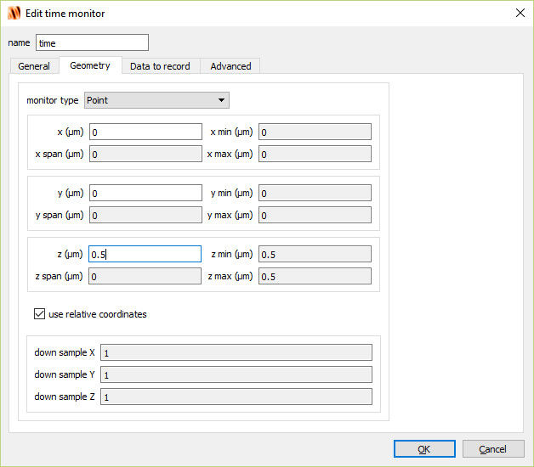
Create time-domain monitor

Slide 23
Create movie monitor
To create a simulation window and edit the properties:
Monitors → Movie
Right click on MovieMonitor in Objects Tree; select Edit object

Slide 24
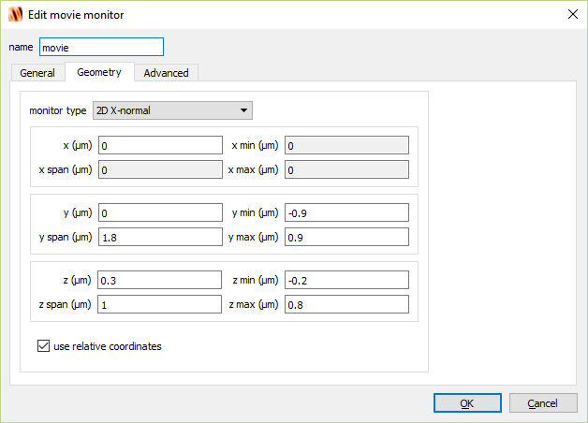
Create movie monitor

Slide 25
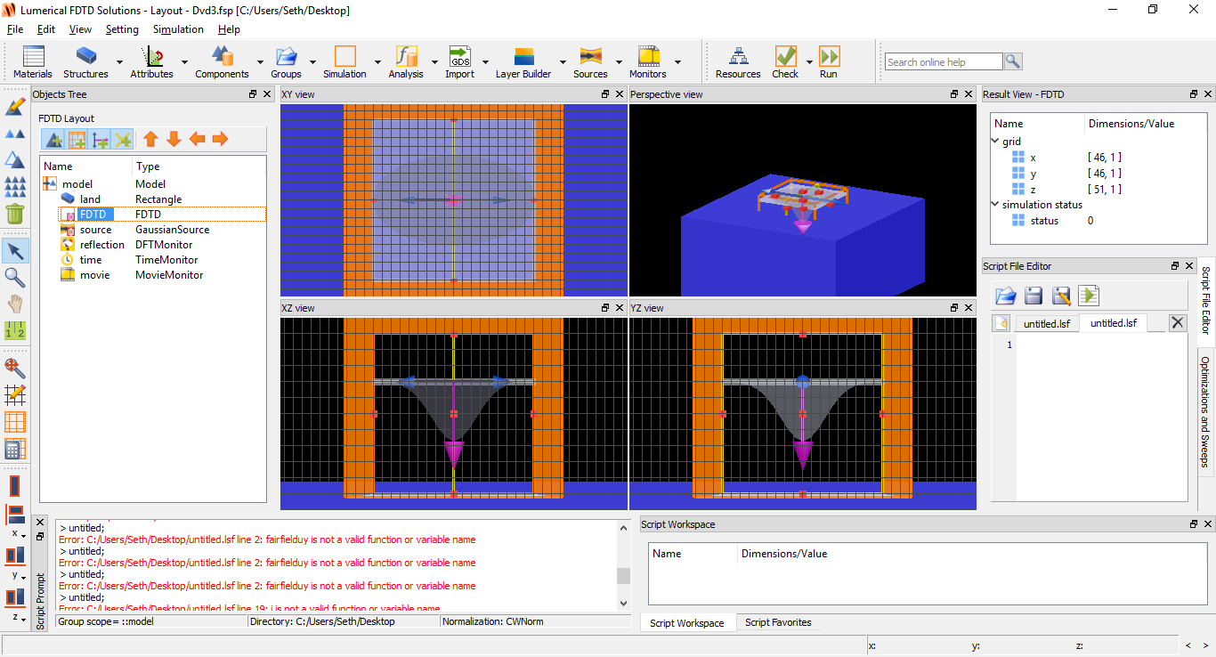
Run simulation
Click the Run icon, save as file of your choice

Slide 26
Run simulation
When done, open .mpg file created in simulation folder

Slide 27
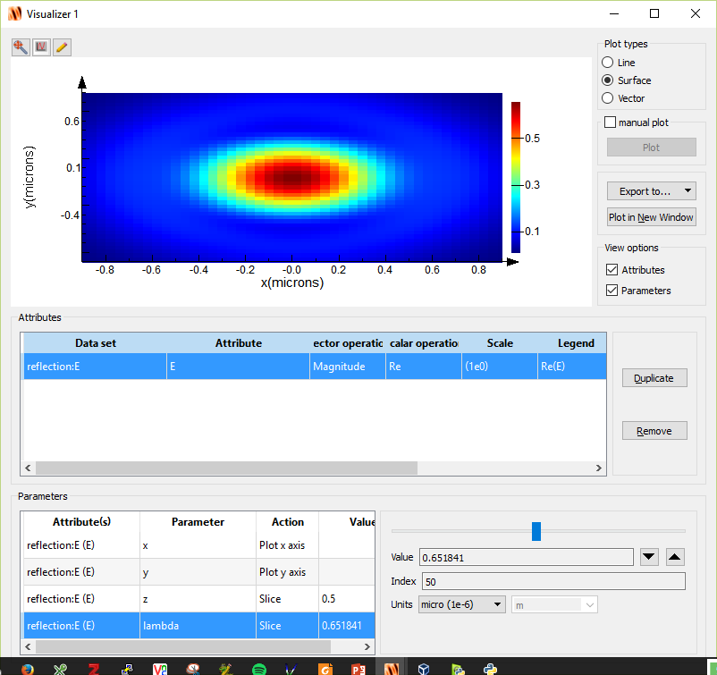
Analyze field-monitor
Right-click reflection → visualize → E
Click lambda in the Parameters window.
Drag the slider until Value ~ 0.650

Slide 28
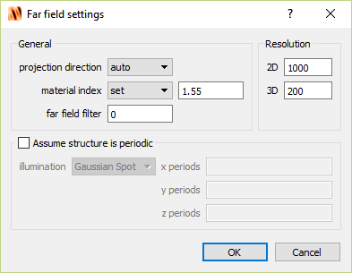
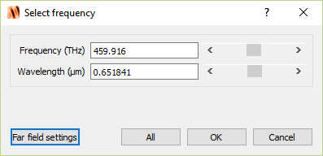
Far-field calculation
In the Result View (lower left), right-click farfield and click Calculate
Set the wavelength near ~0.650 um and click Far Field settings.
Set the material index to 1.55

Slide 29
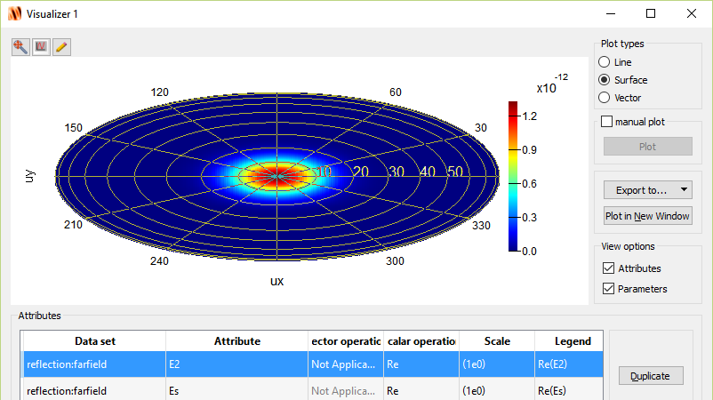
Far-field calculation
In the Result View, right-click farfield and click Visualize

Slide 30
Far-field calculation
These results are not too interesting. All we are observing is the simple reflection of a laser beam from a metallic surface.
Let’s add a DVD ‘pit’

Slide 31
Create ‘pit’ geometry
We will create a rectangle consisting of Aluminum.
To create a rectangle and edit the properties:
Structures → Rectangle
Right click on rectangle in Objects Tree; select Edit object

Slide 32
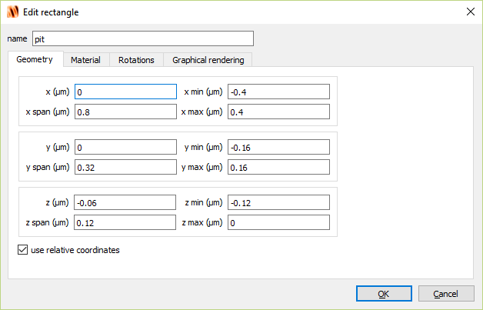
Create ‘pit’ geometry

Slide 33
Create ‘pit’ geometry

Slide 34
Run simulation
When done, open .mpg file created in simulation folder

Slide 35
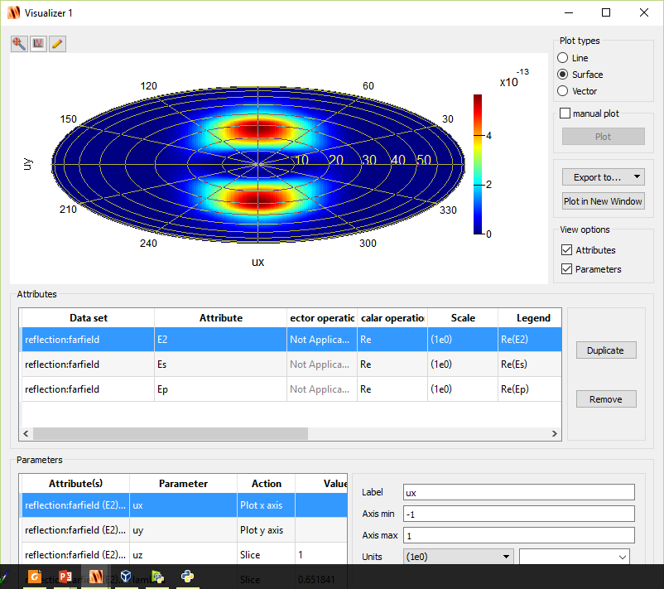
Far-field
Lobes indicate that light is scattered away at angles

Slide 36
How to maximize scattering?
Polycarbonate (n=1.55)
Let’s loosely think of the laser beam as impinging optical rays.
$$Δφ_{1}$$
$$Δφ_{2}$$
Some of the rays (red) will hit the pit and reflect back with a phase change of $Δφ_{1}=π.$
Other rays (blue) will hit the land and reflect back with a phase change of $Δφ_{2}=π+4πnd/λ$
d
($E\sim e^{i\left(\frac{2πn}{λ}\right)⋅x}$)
pit
land
Destructive interference for$\left|Δφ_{2}−Δφ_{1}\right|=π$
What happens to the light? It’s scattered away!
We can quickly calculate that we need $d=λ/4n=120nm$ for destructive interference to occur.
Aluminum

Slide 37
How to maximize scattering?
What if $\left|Δφ_{2}−Δφ_{1}\right|=2π?$
Then we have constructive interference and we should expect that most light will be reflected straight back as if there was no ‘pit’ present.
Then we need $d=240nm$
Let’s test this out...
Polycarbonate (n=1.55)
$$Δφ_{1}$$
$$Δφ_{2}$$
d
pit
land
Aluminum

Slide 38
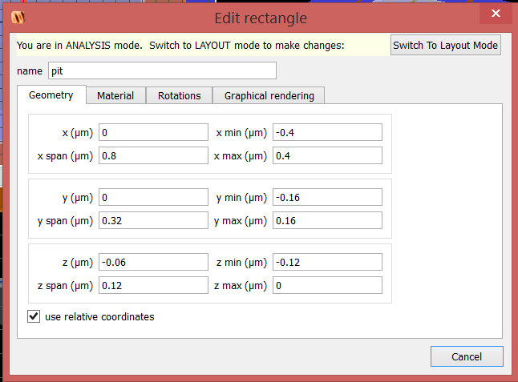
Edit ‘pit’ geometry
Run it again…

Slide 39
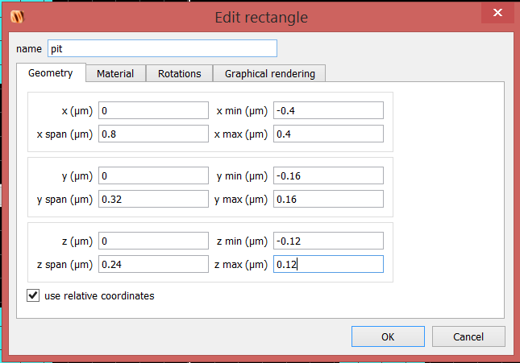
Edit ‘pit’ geometry
Run it again
Visualize far field

Slide 40
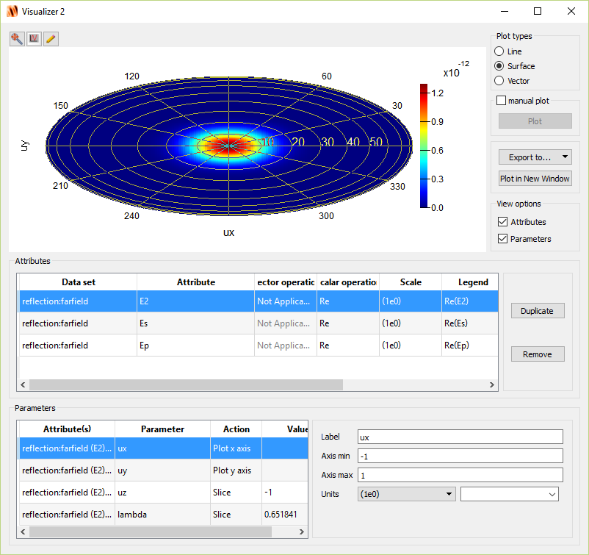
Far-field
Most light is scattered straight back as if ‘pit’ is not present!

Slide 41
Far-field comparison
240nm
pit
120nm
pit
land
land

Slide 42
Next time
Waveguides
Theory of slab waveguide
Simulation with Lumerical MODE and FDTD

